Slide 1



COURSE CODE: CAP588
MOBILE APPLICATION DEVELOPMENT

Slide 2


Today’s Topics:
Mobile User Interface

Slide 3
EFFECTIVE USE OF SCREEN REAL ESTATE
The amount of space available on a display for an application to provide output. Typically, the effective use of screen real estate is one of the most difficult design challenges because of the desire to have as much data and as many controls as possible visible on the screen to minimize the need for hidden commands and scrolling.
Effectively use screen real estate by embracing minimalism, maintaining a clear visual hierarchy, and staying focused.

Slide 4
Embrace Minimalism
Limit the features available on each screen, and use small, targeted design features.
Content on the screen can have a secondary use within an application, but the application designer should be able to explain why that feature is taking up screen space.
Banners, graphics, and bars should all have a
purpose.

Slide 5
USE A VISUAL HIERARCHY
Users will be drawn to larger items, more intense
colors, or elements that are called out with bullets or arrows; people tend to scan more quickly through lighter color contrast, less-intense shades, smaller items, and text-heavy paragraphs.
A consistent hierarchy means consistent usability; mobile application creators can create a hierarchy
with position, form, size, shape, color, and contrast.

Slide 6
Stay Focused
Start with a focused strategy, and keep making decisions to stay focused throughout development.
A smaller file size is a good indicator of how fast an application will load, so the benefits of fighting feature creep extend beyond in-application user experience.

Slide 7
UNDERSTANDING MOBILE APPLICATION USERS
Key principles
proximity,
closure,
continuity,
figure and ground, and
similarity

Slide 8
Proximity
Users tend to group objects together. Elements placed near each other are perceived in groups; as shown in Figure 4-1, people will see one group of three gears, and one group of two gears.

Slide 9
Closure
If enough of a shape is available, the missing pieces are completed by the human mind. In perceiving the unenclosed spaces, users complete a pattern
by filling in missing information. Figure 4-2 illustrates the concept of closure: people recognize a triangle even though the figure is not complete.

Slide 10
Continuity
The user’s eye will follow a continuously-perceived object. When continuity occurs, users are compelled to follow one object to another because their focus will travel in the direction they are already looking.

Slide 11
Figure and Ground
A figure, such as a letter on a page, is surrounded by white space, or the ground. In Figure 4-4, the figure is the gear icon, and the ground is the surrounding space.

Slide 12
Similarity
Similar elements are grouped in a semi automated manner, according to the strong visual perception of color, form, size, and other attributes (see Figure 4-5). In perceiving similarity, dissimilar objects become emphasized.

Slide 13







WHAT IS USABILITY?
Matching
People’s
Products/Services
Work model
Tasks
Work flow
User language
Expectations
  UI metaphor
  Features
  Structure
  UI Language
  Capabilities

Slide 14
USABILITY ISSUES
Mobile applications, referred to software systems operating on mobile devices, are evolving rapidly, making ubiquitous information access at any time and anywhere a true reality.
For example, many mobile applications have brought Internet services to mobile devices .
In the business area, M-Commerce (Mobile e-Commerce) applications, such as mobile banking and advertising, extend electronic businesses to mobile devices.
Customers can check their bank account balances and carry out business transactions through their cell phones

Slide 15
Examining usability of mobile applications, including :
mobile context,
connectivity,
small screen size,
different display resolutions ,
limited processing capability and power, and
restrictive data entry methods.

Slide 16
REQUIREMENT FOR A GOOD USER INTERFACE
Expert vs. novice users – the tale of two audiences
Ideal button size
UI location
Accounting for motion
How much is too much

Slide 17
EXPERT VS. NOVICE USERS – THE TALE OF TWO AUDIENCES
Novice users, for example, tend to move slower throughout the application, are prone to making more touch errors, and are more uncertain about the functionality of each button. Expert users, on the other hand, tend to have the app elements memorized and move quickly and with intent throughout the app.
When creating your app’s user interface, you want to make it efficient enough for your expert users while being informative and simple enough for novice users.

Slide 18
IDEAL BUTTON SIZE
Button sizes are generally limited by the size of our fingers, and so if they are too small, users will be unable to touch them accurately. Button widths below 1cm are harder (and slower) to touch. Aside from the minimum size, there are some benefits to non-uniform button sizes (they give an indication to novice users as to which button is more important).

Slide 19
UI LOCATION
Usually, application UI elements are either placed at the bottom of the app (most common) or at the top.
However, the way most users hold their phone is by using their thumb as the primary finger for touching buttons. If the user is right-handed, the thumb will more easily reach the region at the bottom right of the screen

Slide 20
ACCOUNTING FOR MOTION
We also need to keep in mind that the thumb generally has a specific flow direction.
f you have a user interface control that requires motion (i.e. a slider, a selection list, etc.), keep in mind how a user is holding the phone and that certain motions are generally more natural for the user.

Slide 21
HOW MUCH IS TOO MUCH
Some applications tend to pack quite a few buttons into each of the application views.
Now, even if the buttons are of a decent size so that a user can click on them, there is another issue that app designers should be aware of. The more buttons presented to the user at one time, the more difficult it is for the user to choose one of them (this is especially true for novice users).
http://www.slideshare.net/OpenRoad/mobile-ui-design-user-centered-design-and-ui-best-practices

Slide 22
THE TECHNICAL ATTRIBUTES OF TASK ANALYSIS
Task analysis the analysis of how a task is accomplished.
Since the 1980s, a major change in technical documentation has been to emphasize the tasks performed with a system rather than documenting the system itself. In software documentation particularly, long printed technical manuals that exhaustively describe every function of the software are being replaced by online help organized into tasks.
With the development of XML as a markup language suitable for both print and online documentation

Slide 23
CONTEXTUAL INQUIRY DEVELOPMENT CYCLE
What is Contextual Inquiry?
  An interpretative field research technique
  Used to define requirements, plans and designs
  Depends on conversations with users in the context of their work

Slide 24
KEY CONCEPTS IN CONTEXTUAL INQUIRY
Context: Understand user needs in the context of their work
Partnership: Work with users as partners in inquiry
Focus: listen and probe from a clear intention

Slide 25
WHAT IS CONTEXT?
Definition: The interrelated conditions within which something occurs or exists
Understand work in its natural environment
  go to the user
  observe real work
  interview while they are working

Slide 26
WHY USE CONTEXTUAL INQUIRY?
To design solutions that support, extend, and transform user’s work with minimal disruption
Evolution
Transform
Extend
Support

Slide 27
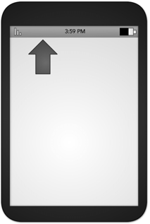
ANNUNCIATOR PANEL
An annunciator panel, seen at the top of Figure, gives information on the state of a mobile device. Though each mobile device will provide a slightly different panel, developers can modify or suppress the annunciatorpanel — which lists the hardware features such as network connection and battery power — within an application

Slide 28
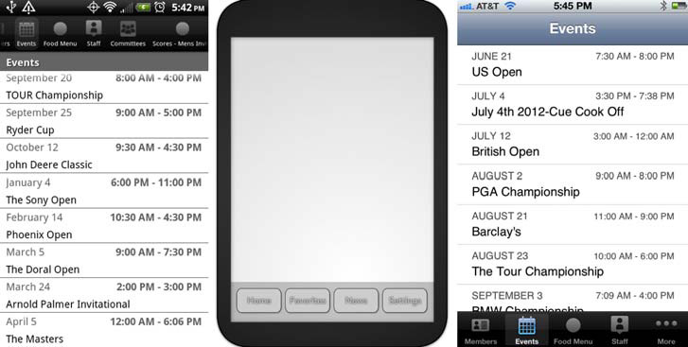
FIXED MENU
Because fixed menus are always accessible (at the bottom and top of Figure 4-8), users can interact with page content as needed.

Slide 29
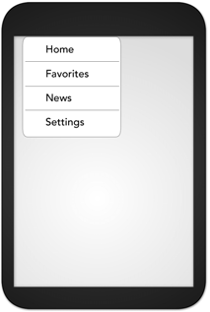
EXPANDABLE MENU
When all function options for one page cannot fit on the viewport, an expanding menu can provide selectively available options.

Slide 30
SCROLL
As in the case of a revealable menu giving additional functionality, there will often be more content on a screen than can be seen in the device viewport.
Make sure that scrolling takes place only on a single axis, if possible. When scrolling must occur both horizontally and vertically, consider providing a thumbnail of the user’s place within the entire scrolling area.
The vertical list (Figure 4-10) simply displays textual information, and is the foundation of information display on many mobile devices.

Slide 31
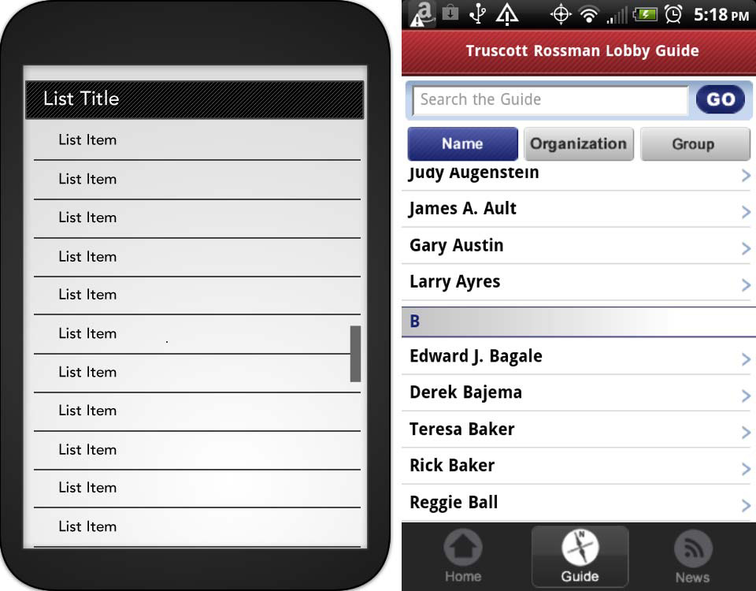
CONTINUED……

Slide 32
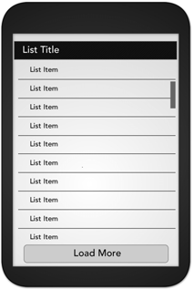
ENDLESS LIST
An endless list of information breaks large data sets into manageable, consumable sizes within the viewport. One portion of content fills the screen, and when users either scroll to the end of a list (predictive retrieval) or select a “more” button (explicit retrieval), the application pulls more data from the server to the device.

Slide 33
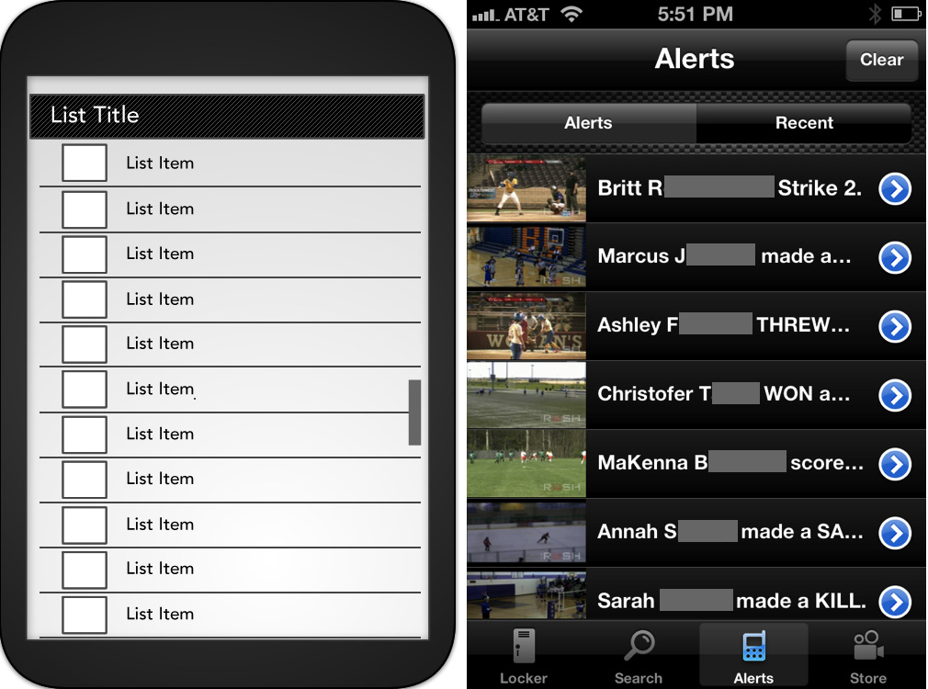
THUMBNAIL LIST
Thumbnails can be replaced by a default icon when a specifi c image
is not available

Slide 34
EXPANDABLE LIST
An expandable list, shown in Figure 4-13, reveals additional, valuable content for selected (touched) list items without leaving the current view.
The content that was visible before the reveal should remain unchanged; the top of the list will remain unchanged and the selected item will expand downward, as in Figure

Slide 35
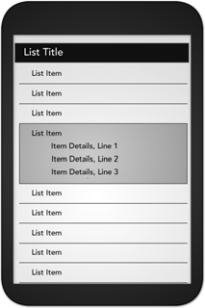
CONTINUED…….

Slide 36
THUMBNAIL GRID
When application information is a group of images that are all or mostly unique, consider using a thumbnail grid. You can use little to no text, and users can either scroll vertically or horizontally through the grid.

Slide 37
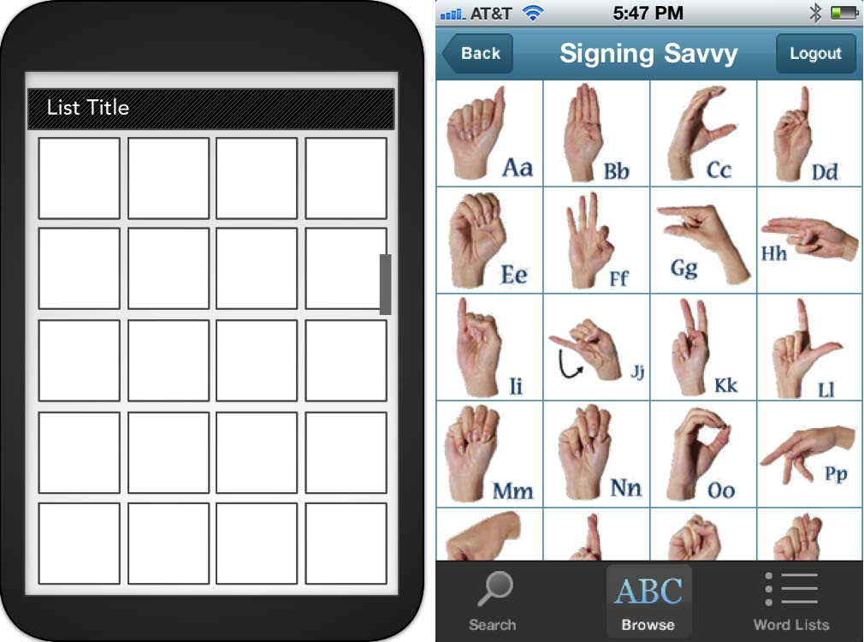
THUMBNAIL GRID

Slide 38


